Slide 1
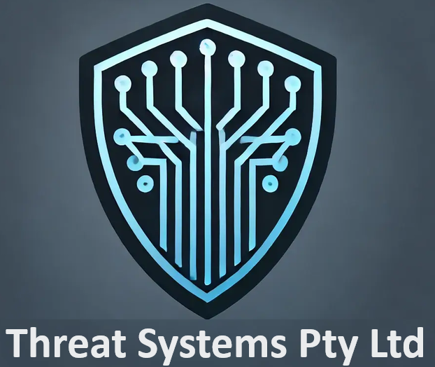
Cyber Security
Project Scope

Slide 2
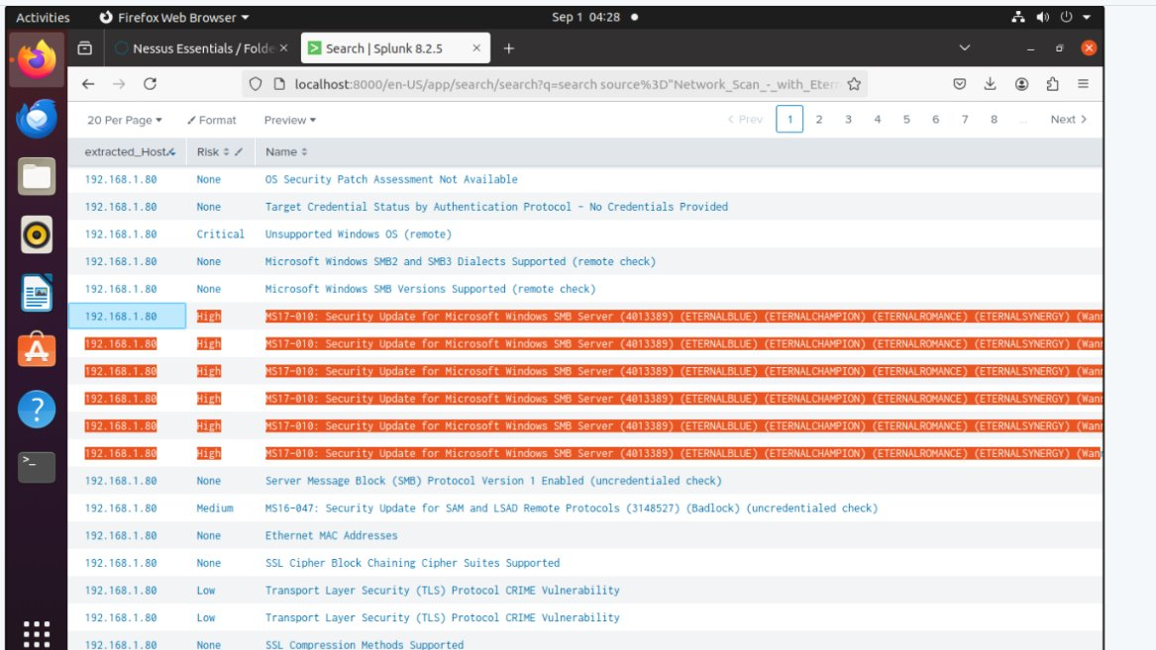
Proof of Concept (PoC) Findings:
Implementing Splunk to trigger real-time alerts on detected network threats will significantly benefit the IT team, which is currently struggling to manage these risks effectively. This setup will equip the team with the necessary tools to monitor and respond to threats efficiently, enhancing overall security management within the business.

Slide 3
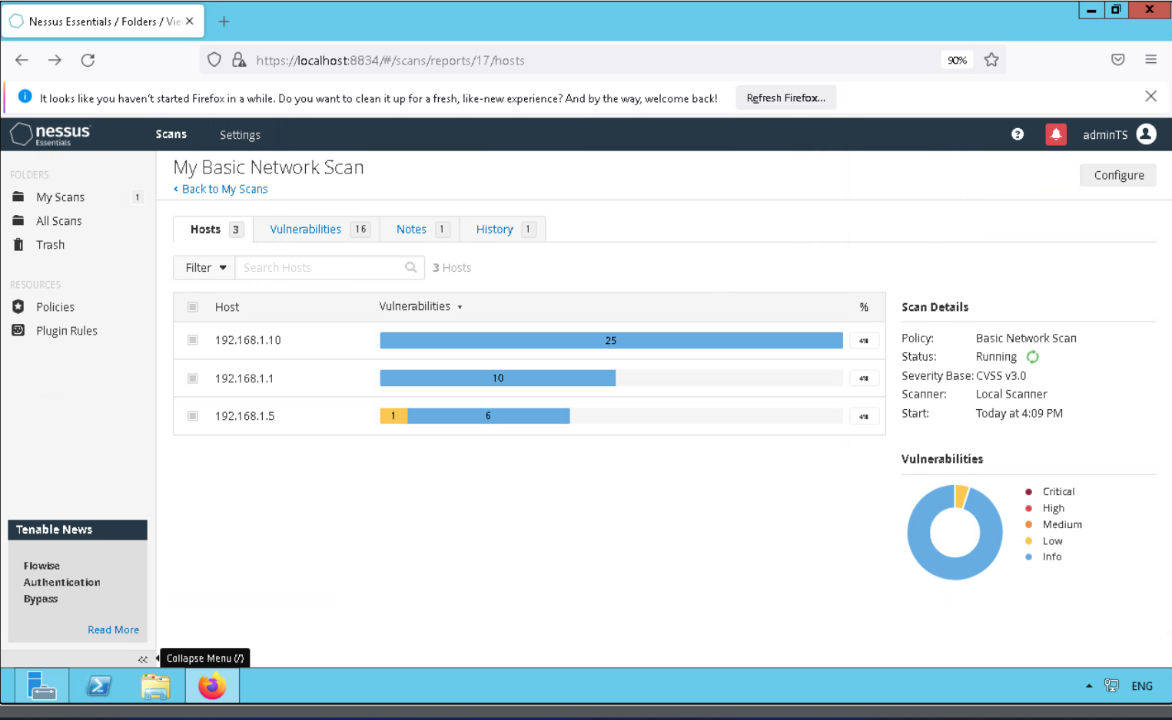
Proof of Concept (PoC) Findings:
Running the Nessus scan identified several vulnerabilities within the PoC network, demonstrating the significant benefits of deploying this tool in a live environment. Early detection of vulnerabilities is crucial for maintaining network security and protecting against potential threats.

Slide 4
Feedback and Considerations:
Client feedback received.
Changes made based on this feedback.

Slide 5
Testing of POC:
How the PoC was tested to ensure it met the problem/scenario requirements:
We implemented a Red Team Exercise by conducting a exploit of MS17-010 which is the Eternal Blue Exploit – Double Pulsar. This exploit allowed access to the Windows 7 PC.
We setup real time alerts to detect a new user being created locally. This triggered an alert in Splunk but we can also make it email alerts to the IT team at Threat Systems.
Being able to get realtime alerts of devices solves the issue with IT Department not being able to manage threats in realtime.

Slide 6
Testing Methodology for Large-Scale Implementation
Overview of Testing Methodology
Phased Testing: Implement a multi-phase testing approach, starting with small-scale pilot tests and gradually scaling up to full implementation.
Environment Simulation: Use simulated environments that closely mirror the production environment to identify potential issues before full deployment.
Load Testing: Conduct load testing to assess system performance under various conditions, ensuring it can handle peak usage.
Quality Assurance Measures
Continuous Monitoring: Implement continuous monitoring during and after testing to promptly identify and address any emerging issues.
Automated Testing: Utilise automated testing tools to ensure consistency and coverage across different scenarios.
User Acceptance Testing (UAT): Engage end-users in testing to validate that the solution meets business requirements and is user-friendly.
Feedback Loop: Establish a feedback loop to incorporate insights from testing into further iterations of the solution, ensuring continuous improvement.

Slide 7
Scaling the PoC
How the PoC Can Be Scaled to Full Implementation
Infrastructure Expansion: Add additional Splunk Servers at each location, enabling data forwarders to centralize logs and analysis back to the main Splunk server.
Network-wide Vulnerability Management: Use Nessus to continuously scan the expanded network, identifying vulnerabilities and detecting new hardware across all locations.
Potential Challenges and Solutions
Data Overload: Manage increased data volumes with efficient indexing and data retention policies in Splunk.
Network Complexity: Mitigate complexities in network topology by ensuring proper configuration and synchronization of Splunk Servers and Nessus scans.
Scalability of Resources: Allocate sufficient resources for both Splunk and Nessus to maintain performance as the network grows.

Slide 8
Training for Client
Training modules or sessions to help the client implement the solution.
Benefits of training.
We recommend setting up the following Training Modules:
Training 1)
Introduction to Splunk
Setting up Splunk Forwarders
Conducting Searches of Indexes
Pre-saved Index Searches and Alerts
Add Data Uploads from Nesuss
Training 2)
Introduction to Nessus
How to Conduct a Network Scan
How to Analyse the Vulnerabilities of devices
Adding the Report Data (CSV) to Splunk
Training On Site Session:
Conduct some real-time exercises and Incident Response Exercises to see how team handles the threats and provide training on steps required.

Slide 9
Incorporating IDS and IPS
Integration of IDS/IPS with Nessus and Splunk
Data Integration: IDS/IPS alerts integrated into Splunk for real-time monitoring and analysis.
Correlation: Combines IDS/IPS data with Nessus vulnerability scans for contextual threat detection.
Automated Responses: IPS systems automatically block threats; Splunk triggers additional security workflows.
Visibility: Splunk dashboards provide comprehensive views of IDS/IPS activity.
Advantages of IDS/IPS
Enhanced Security: Real-time threat detection and prevention.
Proactive Protection: Blocks vulnerabilities before exploitation.
Improved Incident Response: Streamlined processes via Splunk’s analytics.
Including IDS and IPS in your security stack, integrated with Nessus and Splunk, offers a robust approach to vulnerability management, threat detection, and incident response. This combination not only strengthens the overall security posture but also provides actionable insights and automated capabilities to protect the organisation from evolving cyber threats.

Slide 10
Red and Blue Team Exercises
Red Team Exercises:
Vulnerability Exploitation: Exploit known vulnerabilities identified by Nessus to test Splunk's ability to detect and log these activities.
Simulated Ransomware Attack: Deploy simulated ransomware to see if Splunk detects the abnormal file access patterns.
Unauthorized Access Attempts: Simulate unauthorized access to systems by exploiting vulnerabilities, monitoring how Splunk handles these events.
Blue Team Exercises:
Log Correlation and Analysis: Use Splunk to correlate logs from Nessus scans with real-time data to identify potential threats.
Alert Tuning: After red team exercises, tune Splunk alerts to minimize false positives and improve detection accuracy.
Vulnerability Management: Utilise Nessus findings to update Splunk dashboards, prioritising vulnerabilities for remediation efforts.

Slide 11
Business Implications of Cybersecurity
In today’s digital landscape, cybersecurity is not just an IT concern but a critical business imperative. Ensuring that cybersecurity solutions meet rigorous standards is essential to safeguarding your organisation's data, operations, and reputation. This section explores the business implications of cybersecurity, highlighting the risks associated with solution failures and the potential impacts of cyber events on the organisation.
Risks if the Solution Fails to Meet Requirements:
Data Breach: Exposure of sensitive data leading to legal and financial repercussions.
Operational Downtime: System failures or disruptions impacting business continuity.
Reputational Damage: Loss of customer trust and potential decline in market position.
Business Impact of Potential Cybersecurity Events:
Financial Losses: Costs associated with data breaches, regulatory fines, and recovery efforts.
Legal Consequences: Penalties from non-compliance with data protection laws and regulations.
Competitive Disadvantage: Erosion of customer confidence leading to loss of business to competitors.

Slide 12
Conclusion and Next Steps
Final Thoughts: The Proof of Concept has demonstrated the value of integrating Splunk and Nessus into your network for enhanced threat detection and vulnerability management. This approach will significantly improve your IT team’s ability to manage security risks effectively.
Next Steps: We recommend moving forward with a phased implementation, starting with critical areas of your network. We'll also schedule follow-up sessions to fine-tune the setup and ensure it aligns with your business needs.
Opportunity for Questions: We now invite any questions you may have and are here to discuss how we can tailor this solution to best meet your objectives.

